Slide 1
CET311
Project Management
Lecture 03
Dr R L Warrender

Slide 2
Precedence Networks
Precedence network
Becoming more common
Often preferred by project managers

Slide 3
Precedence Networks
Syntax the same as for On Arrow networks
Except there are no dummy activities
Precedence networks must start with a start node and end with a end node
Notes:
We will look at these so called ‘dummy activities’ later in the tutorial period

Slide 4
Precedence Networks
A simple precedence network
a
d
g
Start
b
e
End
c
f
h
Notes:
Start and end nodes.
Tasks in the boxes (NOT on arrows). Arrows on precedence diagrams are just direction flow.

Slide 5
Equivalent On-Arrow Network
This is the same network drawn as an On Arrow network
2
d
a
5
g
e
b
Start
1
7
End
3
h
c
f
6
4

Slide 6
Precedence Networks
Draw the following as an Precedence network and an On Arrow Network
Tasks Precedence Time
a - 5 days
b - 4 days
c a 6 days
d b 2 days
e b 5 days
f c,d 8 days

Slide 7
Precedence Networks
The completed Precedence Network
a
c
Start
d
f
End
b
e

Slide 8
Equivalent On-Arrow Network
The same network drawn as an On Arrow Network
c
a
2
4
f
start
1
b
d
5
end
e
3

Slide 9
Precedence Networks
Draw another precedence and on arrow network
Tasks Precedence Time
a - 6 weeks
b - 4 weeks
c a 3 weeks
d b 4 weeks
e b 3 weeks
f - 10 weeks
g e,f 3 weeks
h c,d 2 weeks

Slide 10
Precedence Networks
The completed Precedence Network
a
c
Start
d
h
End
b
e
g
f

Slide 11
Equivalent On-Arrow Network
This is the same network drawn as an On Arrow network
2
C=3
A=6
B=4
D=4
H=2
1
3
4
6
E=3
G=3
F=10
5

Slide 12
Precedence Networks
Adding more information to the node
Duration
Earliest
start
Earliest
Finish
ES
D
EF
Description
LS
F
LF
Latest
Start
Latest
Finish
Float

Slide 13
Precedence Networks
Redraw the following with complete information in each node box
Tasks Precedence Time
a - 5 days
b - 4 days
c a 6 days
d b 2 days
e b 5 days
f c,d 8 days

Slide 14
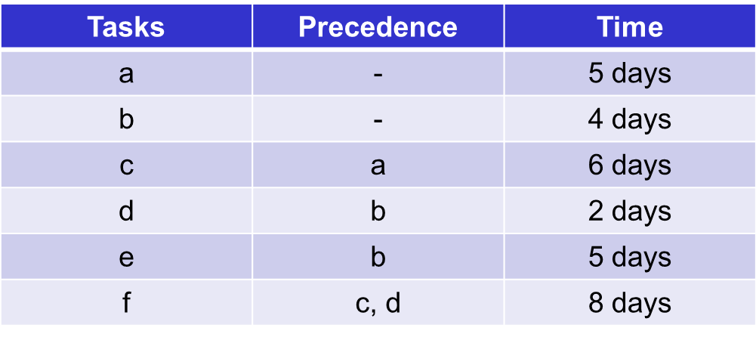
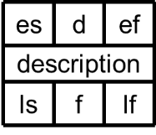
Draw Event Nodes
a
c
f
End
Start
d
b
e

Slide 15
Duration
5
6
a
c
8
0
0
f
End
Start
2
4
d
b
5
e

Slide 16
Forward Pass Earliest Start / Earliest Finish
0
5
6
a
c
8
0
0
0
0
f
End
Start
2
4
d
b
5
e
Notes:
Transpose the Earliest Finish from the preceding Activity into the Earliest Start of the next Activity.

Slide 17
Forward Pass Earliest Start / Earliest Finish
0
5
5
5
6
a
c
8
0
0
0
0
f
End
Start
4
2
0
4
4
d
b
4
5
e
Notes:
Transpose the Earliest Finish from the preceding Activity into the Earliest Start of the next Activity.
Add the duration of the Activity to get the Earliest Finish for that Activity. Transpose that number into the following Activity as its Earliest Start.

Slide 18
Forward Pass Earliest Start / Earliest Finish
0
5
5
5
6
11
a
c
11
8
19
19
0
19
0
0
0
f
End
Start
4
2
6
0
4
4
d
b
4
5
9
e
Notes:
Transpose the Earliest Finish from the preceding Activity into the Earliest Start of the next Activity.
Add the duration of the Activity to get the Earliest Finish for that Activity. Transpose that number into the following Activity as its Earliest Start.
Remember to use the highest value if you’ve got 2 or more preceding activities (i.e. the greatest amount of time taken through the project to get to that point).
Filter through the Precedence Network or Precedence Diagram to find the total duration of the project, i.e. the Earliest Start of the End node (which also equals Earliest Finish).
The Start and End tasks have zero duration.

Slide 19
Backward Pass Latest Finish / Latest Start
0
5
5
5
6
11
a
c
11
8
19
19
0
19
0
0
0
f
End
Start
4
2
6
19
19
0
4
4
d
b
4
5
9
e
Notes:
Latest Finish and Latest Start of the End task are the same and are equal to the total project time.

Slide 20
Backward Pass Latest Finish / Latest Start
0
5
5
5
6
11
a
c
11
8
19
19
0
19
0
0
0
f
End
Start
4
2
6
11
19
19
19
0
4
4
d
b
4
5
9
e
Notes:
Latest Finish and Latest Start of the End task are the same and are equal to the total project time.
Transpose the Latest Start (number/date) of the End task to be the number of the Latest Finish of the preceding task.
That number minus the duration of that task equals the Latest Start of that task.

Slide 21
Backward Pass Latest Finish / Latest Start
0
5
5
5
6
11
a
c
5
11
11
8
19
19
0
19
0
0
0
f
End
Start
4
2
6
11
19
19
19
0
4
4
d
b
9
11
4
5
9
e
14
19
Notes:
Latest Finish and Latest Start of the End task are the same and are equal to the total project time.
Transpose the Latest Start (number/date) of the End task to be the number of the Latest Finish of the preceding task.
That number minus the duration of that task equals the Latest Start of that task.
Transpose into the Latest Finish of the preceding tasks.
Continue through the network diagram.

Slide 22
Backward Pass Latest Finish / Latest Start
0
5
5
5
6
11
a
c
0
5
5
11
11
8
19
19
0
19
0
0
0
f
End
Start
4
2
6
11
19
19
19
0
0
0
4
4
d
b
9
11
5
9
4
5
9
e
14
19
Notes:
Latest Finish and Latest Start of the End task are the same and are equal to the total project time.
Transpose the Latest Start (number/date) of the End task to be the number of the Latest Finish of the preceding task.
That number minus the duration of that task equals the Latest Start of that task.
Transpose into the Latest Finish of the preceding tasks.
Continue through the network diagram.
Note: When you have 2 or more different Latest Start times to be transposed into a preceding task, it is the lowest/smallest number on the backward pass (i.e. the latest date or point of time in the overall project timeframe that the task HAS to be started in order to complete the whole project within the overall shortest amount of time).

Slide 23
Backward Pass Float
0
5
5
5
6
11
a
c
0
5
5
11
11
8
19
19
0
19
0
0
0
f
End
Start
4
2
6
11
0
19
19
0
19
0
0
0
4
4
d
b
9
11
5
9
4
5
9
e
14
19
Notes:
The Float is the amount of spare, or slack, time available between activities.
Quantifying the Float allows the project manager to identify where there is spare capacity and where resources can be reallocated.
The Float equals the difference between the Earliest Start and Latest Start (and the Earliest Finish and Latest Finish) for each activity, i.e. top to bottom figures in each Activity node).
ES - LS = Float
EF - LF = Float

Slide 24
Completed Precedence Network
0
5
5
5
6
11
a
c
0
0
5
5
0
11
11
8
19
19
0
19
0
0
0
f
End
Start
4
2
6
11
0
19
19
0
19
0
0
0
0
4
4
d
b
9
5
11
5
5
9
4
5
9
e
14
10
19
Notes:
The Float is the amount of spare, or slack, time available between activities.
Quantifying the Float allows the project manager to identify where there is spare capacity and where resources can be reallocated.
The Float equals the difference between the Earliest Start and Latest Start (and the Earliest Finish and Latest Finish) for each activity, i.e. top to bottom figures in each Activity node).
ES - LS = Float
EF - LF = Float
The Critical Path is the route through the network diagram with least amount of float or slack time.

Slide 25
Precedence Networks
Redraw the following with complete information in each node box
Tasks Precedence Time
a - 6 weeks
b - 4 weeks
c a 3 weeks
d b 4 weeks
e b 3 weeks
f - 10 weeks
g e,f 3 weeks
h c,d 2 weeks
Notes:
Try this one on your own !

Slide 26
Conclusion
Activity Planning
Precedence analysis
On Arrow networks
Precedence networks

Slide 27
Future Work
Unit 3 – Project Evaluation
Unit 4 – Project Planning
Unit 5 – Project Risk
Unit 6 – Project Quality
Unit 7 – Human Aspects of Projects
Unit 8 – Project Monitoring and Control
Case Study
Notes:
Students will be taken through the various stages of project management, learning the issues that it is important to consider during the project management life cycle:
Project selection, feasibility studies, plans and priorities.
Risk analysis and control.
Project Planning, for example network analysis, PERT, Gantt Charts, task definitions.
Project Management methodologies.
Project Monitoring and Control including cost control, quality control and review structures.
Change and Configuration management.
The human aspects of project management
CASE STUDY At this stage we then go into an interactive case study which develops over the course of around six weeks.
We get you to organise yourselves into teams appointing typical roles as you would in a company scenario to organise how you would run a project and cope with many changes you will face week to week.
This is your chance to use much of what you will have learned in the lecture sessions to see how well your team will face in a competitive market

